Slide 1
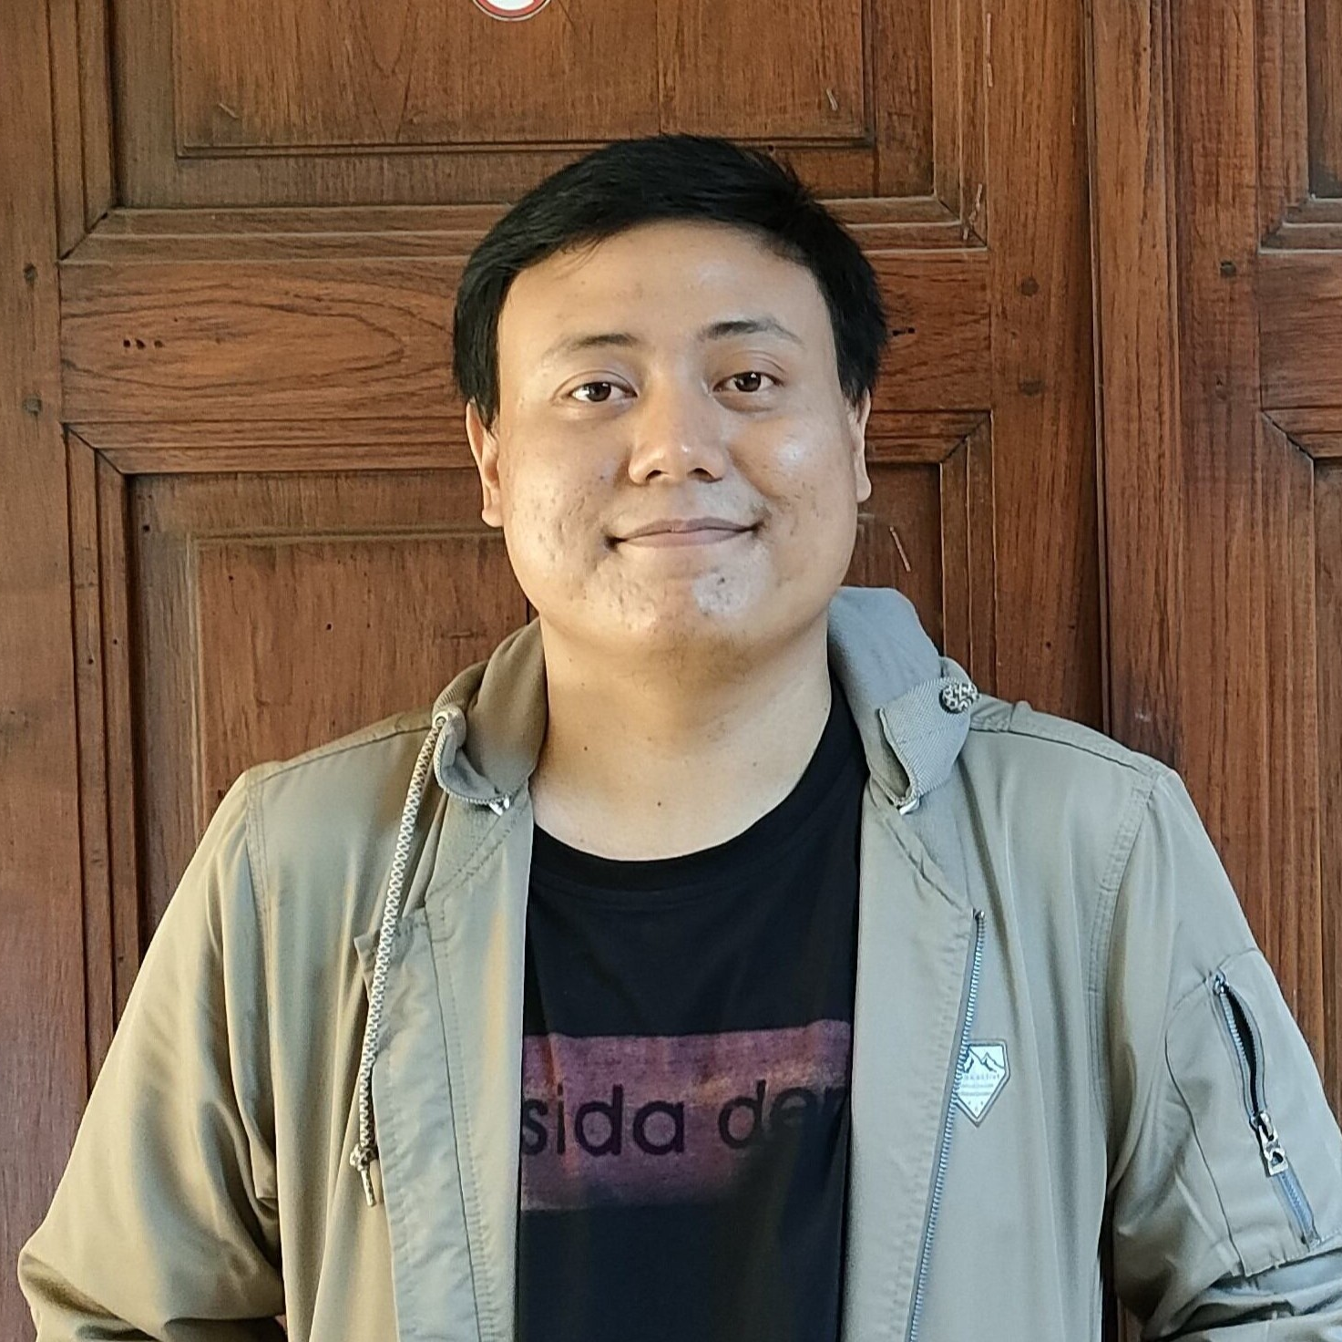
Predict Customer Personality to boost marketing campaign by using Machine Learning
Created by:
Muhammad Cikal Merdeka
Email : mcikalmerdeka@gmail.com
LinkedIn : linkedin.com/in/mcikalmerdeka
Github : github.com/mcikalmerdeka
Dedicated entry-level data scientist with analytical and experimental background of Physics. My graduation 2023, a pivotal year marked by significant advancements in artificial intelligence with the introduction of GPT-4 and other generative AI models, has fueled my curiosity and excitement to delve into the field of data. I have comprehensive grasp of data science methodology from business understanding to modelling process with proficiency in Python, SQL, Tableau, Power BI, Looker Studio and other tools related to data analytics workflow from several coursework and bootcamps.

Slide 2
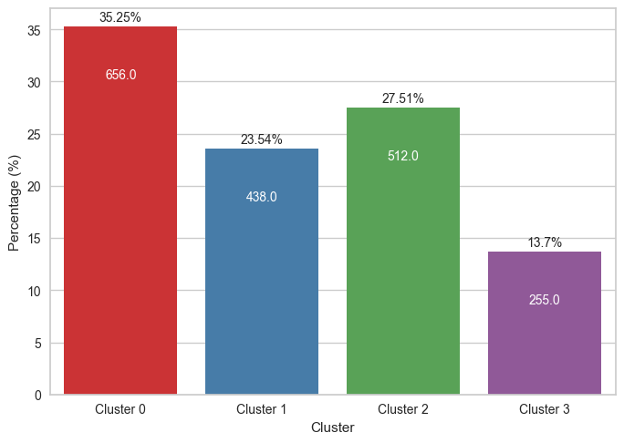
Customer Personality Analysis for Marketing Retargeting
Number of Customers in Each Cluster
The low-spender group in our business has the highest number of customers which is around 35.25%.
The high-spender group constitutes only around 13.7% of the customer base, so it's important for the company to focus on maximizing the value derived from this segment.
The moderate spender groups have similar numbers to each other, with the group with low activity having slightly more. However, considering the significant number of visits for both of these groups, the company can develop suitable marketing strategies.
For more details, you can view the Jupyter notebook here.

Slide 3
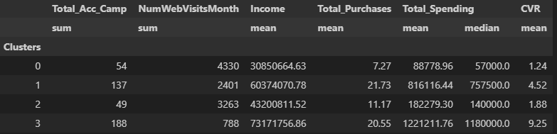
Customer Personality Analysis for Marketing Retargeting
Cluster Interpretation
The results of the previous clustering can be interpreted based on the characteristics of each group, including the tendency of each cluster to respond to existing marketing campaigns and the potential revenue outcomes if we were to perform marketing retargeting on these clusters. The analysis of customer personality in this context involves several variables including:
Total Accepted Campaign, Number of Website Visit, Income, Total Spending, Total Purchases, and Conversion Rate. Here's a brief summary of these 6 variables.

Slide 4
Customer Personality Analysis for Marketing Retargeting
Cluster Interpretation - Aggregation Table Summary
Cluster 0 : Low Spenders
Has the lowest number of transactions and spending, with only about 7 transactions and Rp.57,000 per month.
Has the lowest income, mostly Rp.30,850,000 per year.
Responds to campaigns quite low, only 54 times.
The largest total visits which is 4,330 visits.
Has the lowest conversion rate, only 1.24%.
Cluster 1 : Moderate Spenders Responsive
Has high numbers of transactions and spending, with about 21 transactions and Rp.757,500 per month.
Has a fairly high income, mostly Rp.60,374,000 per year.
Responds to campaigns quite frequently, only 137 times.
The moderate total visits which is 2,401 visits.
Has a moderate conversion rate, 4.52%.
Cluster 2 : Moderate Spenders Non-Responsive
Has moderate numbers of transactions and spending, about 11 transactions and Rp.140,200 per month.
Has a moderate income, mostly Rp.43,200,000 per year.
Responds to campaigns the least, only 49 times.
The fairly high total visits which is 3,263 visits.
Has a relatively low conversion rate, only 1.88%.
Cluster 3 : High Spenders
Has high numbers of transactions and spending, about 20 transactions and Rp.1,180,000 per month.
Has the highest income, mostly Rp.73,171,000 per year.
Responds to the most campaigns, 188 times.
The smallest total visits which is 788 visits.
Has the highest conversion rate, 9.25%.

Slide 5
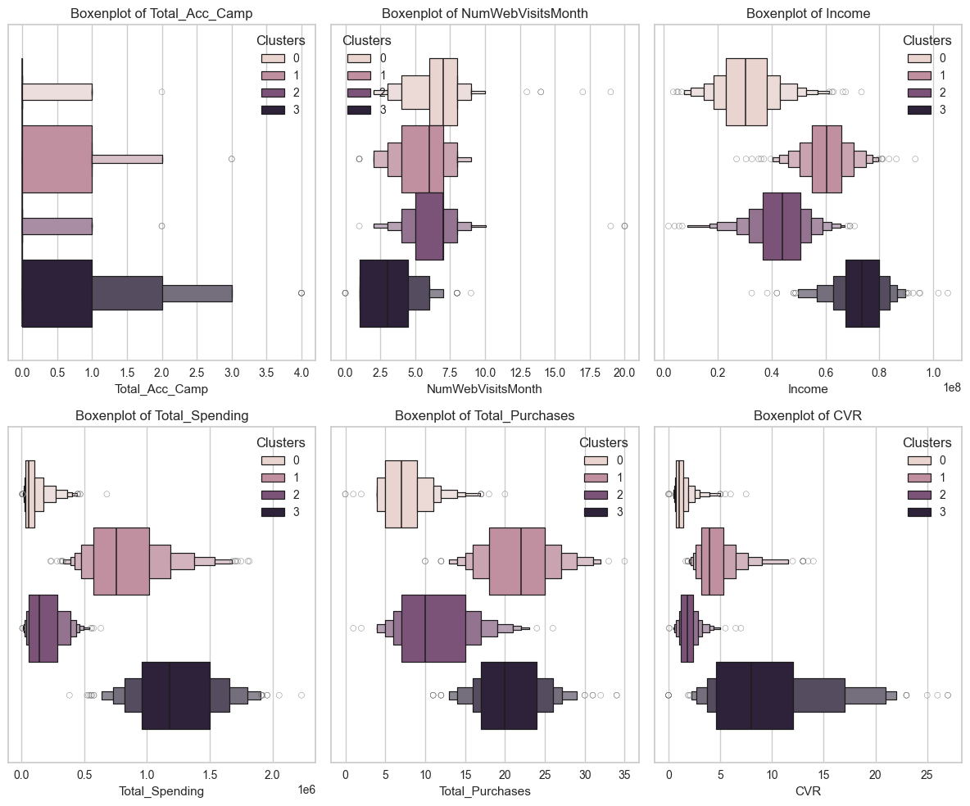
Customer Personality Analysis for Marketing Retargeting
Cluster Interpretation – Boxenplot Visualization
Major Findings :
The Low Spenders (Cluster 0) exhibit a high distribution of website visits but have the lowest total acceptance campaign and conversion rates.
This suggests that this group frequently visits the company's website but may not fully realize or be responsive to the campaigns offered. Considering this group has the largest population, the company needs to develop the right strategy to capture their attention and increase their engagement.
Further analysis may be needed to understand the reasons behind the low acceptance campaign within this group.

Slide 6
Customer Personality Analysis for Marketing Retargeting
Cluster Interpretation – Boxenplot Visualization
Major Findings :
The High Spenders (Cluster 3) is the cluster that responds the most to campaigns and also cluster with the highest conversion rates.
This indicates that the majority of customers in this group are very responsive to the campaigns offered by the company and indeed have a high buying intent, likely correlated with their very high income.
This could be a good opportunity to increase interaction and purchases from this group by launching more attractive and relevant campaigns according to their preferences.

Slide 7
Customer Personality Analysis for Marketing Retargeting
Cluster Interpretation – Boxenplot Visualization
Major Findings :
Moderate Spenders Responsive (Clusters 1 ) and Moderate Spenders Non-Responsive (Clusters 2) are quite tricky to analyze because the majority of their customers neither visit the company's website too often nor too rarely and their income didn’t have significant difference.
However, the main difference between the two lies in number of accepted campaign, conversion rate and spending habits where Cluster 1 indeed has more intense spending habits compared to Cluster 2.
The company can leverage this information to design campaign strategies that target the middle to lower income groups more effectively.

Slide 8
Customer Personality Analysis for Marketing Retargeting
Business Recommendation
Cluster 0 : Low Spenders
Targeted Campaigns
Develop personalized and targeted campaigns to increase engagement and conversion rates among this group. Since they visit the website frequently but have low responsiveness to campaigns, analyzing their behavior further can help tailor campaigns to their preferences and needs.
Enhanced User Experience
Improve the website's user experience to make it more engaging and user-friendly for this segment. This could involve simplifying the purchasing process, providing personalized recommendations, or offering incentives to encourage repeat visits and purchases.
Cluster 1 : Moderate Spenders Responsive
Upselling and Cross-selling
Implement upselling and cross-selling strategies to increase the average transaction value for this segment. Since they already have a relatively high number of transactions and spending, enticing them with complementary or higher-value products/services can boost revenue.
Campaign Optimization
Continuously optimize marketing campaigns to maintain their relatively high responsiveness. Analyze past campaign performance to identify patterns and preferences, then tailor future campaigns accordingly to maximize engagement and conversion rates.

Slide 9
Customer Personality Analysis for Marketing Retargeting
Business Recommendation
Cluster 2 : Moderate Spenders Non-Responsive
Reactivation Campaigns
Launch reactivation campaigns targeting this segment to encourage them to increase their activity and engagement with the company. Offering special promotions or discounts can incentivize them to make more transactions and visits to the website.
Content Marketing
Invest in content marketing strategies to increase awareness and engagement among this group. Providing valuable and informative content through blog posts, guides, or tutorials can attract their interest and encourage them to interact more with the company's offerings.
Cluster 3 : High Spenders
Exclusive Offers
Provide exclusive offers or loyalty programs to reward and retain this segment of high spenders. Offering VIP perks, early access to new products, or personalized discounts can strengthen their loyalty and increase their lifetime value to the business.
Personalized Services
Offer personalized services such as dedicated account managers or concierge services to enhance the customer experience for high spenders. Providing tailored assistance and support can further solidify their satisfaction and encourage repeat purchases.

